Slide 1
Computer Architecture (Fall 2021)
Lecture 6
Instruction Set Principles
Dr. Yujuan Tan (谭玉娟)
Office: Main Building 0626
Email: tanyujuan@cqu.edu.cn

Slide 2

Early 1960s: IBM Starts Talking of “Computer Architecture”
“the term architecture is used here to describe the attributes of a system as seen by the programmer, i.e., the conceptual structure and functional behavior, as distinct from the organization of the data flows and controls, the logic design, and the physical implementation.”
M. Amdahl, G. A. Blaauw, and J. F. P. Brooks. "Architecture of the IBM System/360," IBM Journal of Research and Development, 1964.
• Early 1960s: IBM launches the IBM 360 , a landmark ISA
– IBM coins the term computer architecture to refer to the program-
visible portion of the instruction set
• today the term has a broader meaning (design the whole computer system)
– a family of computers that are able to run the same software
• this “family” concept (a platform in today’s jargon) was quite novel at the
time (IBM had 5 different architectures before the 360)
– the first successful computer with a general-purpose register (GPR)
organization

Slide 3

Shift in Applications Area
Desktop Computing – emphasizes performance of programs with integer and floating point data types; little regard for program size or processor power
Servers - used primarily for database, file server, and web applications; FP performance is much less important for performance than integers and strings
Embedded applications value cost and power, so code size is important because less memory is both cheaper and lower power
DSPs and media processors, which can be used in embedded applications, emphasize real-time performance and often deal with infinite, continuous streams of data
Architects of these machines traditionally identify a small number of key kernels that are critical to success, and hence are often supplied by the manufacturer.

Slide 4
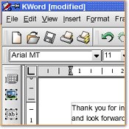
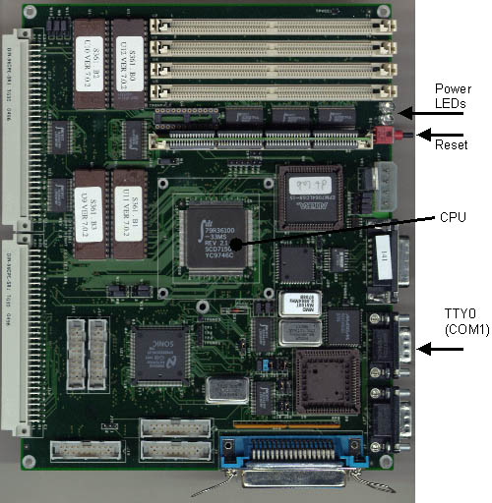

What is ISA?
Instruction Set Architecture – the computer visible to the assembler language programmer or compiler writer
ISA includes
Programming Registers
Operand Access
Type and Size of Operands
Instruction Set
Addressing Modes
Instruction Encoding
software
hardware
Instruction
set

Slide 5

Computer Architecture and Abstraction Layers
applications
algorithms
high-level languages
standard libraries & operating systems
instruction set architectures (ISA)
micro-architectures (RTL)
logic gates
circuits
devices, metal lines
• interface
• articulation
point

Slide 6
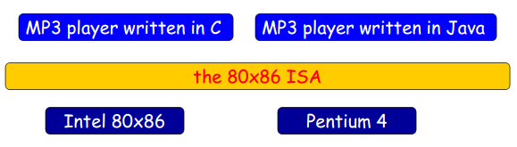
ISA: Articulation Point between HW & SW
• Articulation point of the design process
– decouples implementation and specification
• the HW implementation of the microprocessor is decoupled
from the specification of the instruction set
– decouples high-level and programs languages from
the abstract machine
• through the role played by the compiler/interpreter

Slide 7
ISA: Interface between HW & SW
• Abstraction layer
– that hides the details of the underlying levels while
exposing the key information to optimize the design
• state of the microprocessor (registers, memory, PC)
• HW-supported instructions to operate on this state
– theoretically limits the space of design exploration,
yet still enables good results in a more predictable,
and often shorter time
• high-level languages + compiler optimizations vs.
manual optimization of hand-written assembly code
– enables the completion of more complex projects by
simplifying the validation phase
Notes:
•抽象层
–这隐藏了底层的细节，而
公开关键信息以优化设计
•微处理器状态（寄存器、存储器、PC）
•在该状态下操作的硬件支持指令
–理论上限制了设计探索的空间，
但仍然能够以更可预测的方式实现良好的结果，
而且时间通常更短
•高级语言+编译器优化vs。
手工优化手写汇编代码
–通过以下方式完成更复杂的项目：
简化验证阶段

Slide 8
Taxonomy of ISAs
Computer Architectures are classified into three classes according to the Register Structures for operands storage
Stack Architecture: operands are implicitly on the top of the stack
AC Architecture: one operand is implicitly accumulator
General Purpose Register Computer Architecture
only explicit operands, either registers or memory locations
register-memory: access memory as part of any instruction
register-register: access memory only with load and store instructions
Input Bus
Input Bus
General
Purpose
Registers
ALU
Other
Registers
AC
Registers
Stack
ALU
ALU
Stack Architecture
Output Bus
Output Bus
AC Architecture
GPR Architecture

Slide 9
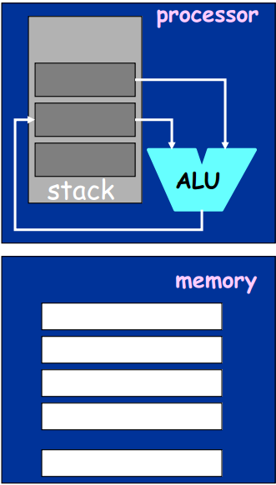
Taxonomy of ISAs: Stack
• Instruction operands
– none (implicit) for ALU operations
- one for transfer from/to
memory
• push/pop
• Pros
– short instruction
– simple compiler
• Cons
– inefficient code
• many swaps, copies
– stack may be slow
• Examples
- B5000, JVM
a = b + (c * d)
push b
push c
push d
mul
add
pop a

Slide 10
Stack Machines
Instruction set:
Arithmetic operators(+, -, *, /, . . .)
push A, pop A
Example: a*b - (a+c*b) ab*(a(cb)*+)-
push a
A
push b
B
A
-
*
A*B
push a
A
A*B
*
+
push c
*
C
A
A*B
a
b
a
push b
A
A*B
B
C
c
b
*
B*C
A
A*B
+
B*C+A
A*B
-
A*B- (B*C+A)

Slide 11
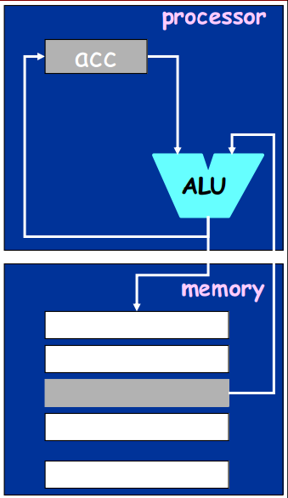
Taxonomy of ISAs: Accumulator
• Instruction operands
– 1 explicit, 1 implicit
• acc←acc + *mem
• acc ← *mem
• *mem ← acc
• Pros
– short instruction
– simple design
• Cons
– inefficient code
• many transfers
– pipelining is hard
• Examples
– Early machines
(EDSAC, IAS)
a = b + (c * d)
load c
mul d
add b
store a

Slide 12
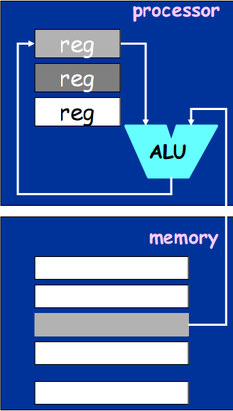
Taxonomy of ISAs: Register-Memory
• Instruction operands
– 2 (typically)
• one from memory
• Pros
– fewer instructions
– dense encoding
• Cons
– operand asymmetry
• result destroys one
– pipelining is hard
• different CPIs
• Examples
– IBM 360, 80x86,
Motorola 68000, TI
a = b + (c * d)
load r1, c
mul r1, r1, d
add r1, r1, b
store r1, a

Slide 13
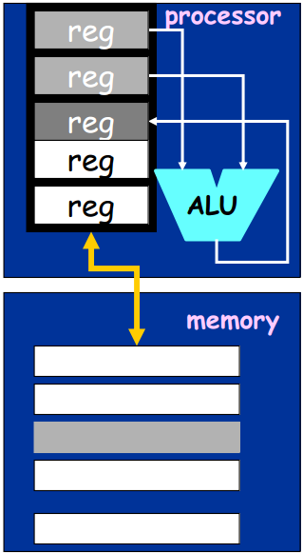
Taxonomy of ISAs: Register-Register (or Load-Store)
• Instruction operands
– 3 (typically)
• from registers
• Pros
– simple, symmetric
• faster instructions
• smarter compilation
• Cons
– higher instr. count
– longer encoding
- lower density
• Examples
- CDC6600, CRAY-1,
Alpha, MIPS, SPARC, PowerPC
a = b + (c * d)
load r1, c
load r2, d
load r3, b
mul r4, r1, r2
add r5, r4, r3
store r5, a

Slide 14
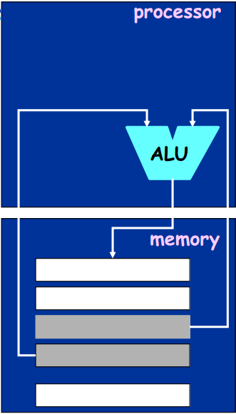
Taxonomy of ISAs: Memory-Memory
• Instruction operands
– 2 or 3 operands
• all from memory
• Pros
– most compact instruction count
- no need of registers
• Cons
– large variation in instruction lengths
• result destroys one
– pipelining is hard
• very different CPIs
• Examples
- VAX (some instr.)
- not used nowadays
a = b + (c * d)
mul e, c, d
add a, e, b

Slide 15
GPR Machines
Type
Register-register
(0,3)
Register-memory
(1,2)
Memory-memory
(3,3)
Advantages
Simple, fixed-length instr. encoding.
Simple code generation model
Data can be accessed without loading first.
Instruction format tends to be easy to encode and yields good density.
Program becomes most compact.
No waste of registers for temporaries.
Disadvantages
Higher instruction count.
Some instructions are short and bit encoding may be wasteful.
A source operand is destroyed.
Clocks per instruction varies by operand location.
Large variation in instruction sizes and in work per instruction.
Memory accesses create memory bottleneck.
Example
(0,3): ADD R1,R2,R3 R[R1] R[R2] + R[R3]
(1,2): ADD R1, X R[R1] R[R1] + M[X]
(3,3): ADD X1,X2,X3 M[X1] M[X2] + M[X3]

Slide 16
GPR Machines
Maximum number of operands(O)
two or three operands
Number of memory addresses(M)
0,1,2,3
Type
(M,O)
No of memory addresses
Maximum No of
operands allowed
Examples
(0,3)
0 3 SPARC, MIPS, PowerPC, ALPHA
(1,2)
1 2 Intel 80x86, Motorola 68000
(2,2)
2 2 VAX
(3,3)
3 3 VAX

Slide 17
R-R vs RM
A+B+C
RR Instructions
LD R1,A
LD R2,B
LD R3,C
ADD R4,R1,R2
ADD R5,R4,R3
RM instructions
LD R1,A
ADD R1,B
ADD R1,C
RM instructions reduce IC

Slide 18
Interface Design
A good interface:
Lasts through many implementations (portability, compatibility)
Is used in many different ways (generality)
Provides convenient functionality to higher levels
Permits an efficient implementation at lower levels
use
imp 1
time
Interface
use
imp 2
use
imp 3

Slide 19
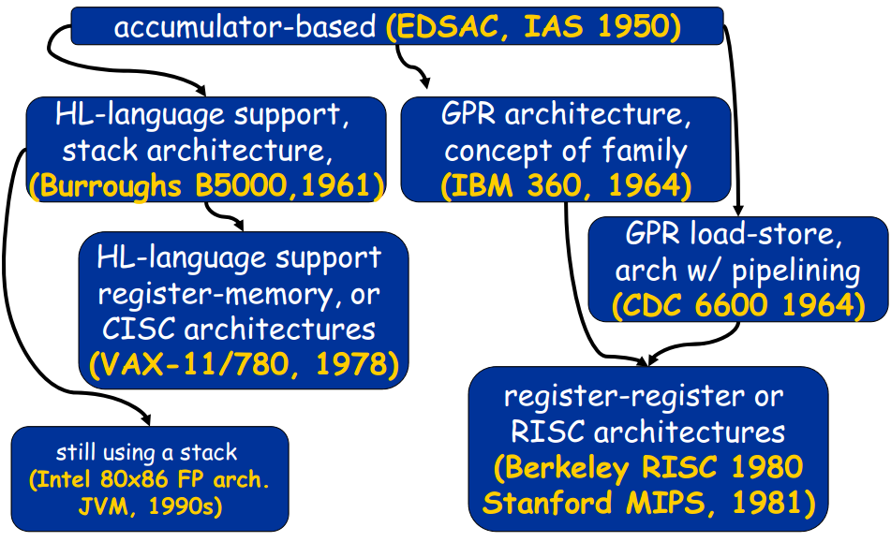
Evolution of ISAs

Slide 20
Evolution of Instruction Sets
Major advances in computer architecture are typically associated with landmark instruction set designs
Ex: Stack(B1700) vs GPR (System S/360)
Design decisions must take into account:
technology(component)
machine organization
programming languages
compiler technology
operating systems
And they in turn influence these

Slide 21
Did RISC win?
• RISC architectures have been successfully applied
in all three main computing domains
– desktop, server, embedded
• But one of the most, if not the most, successful
architecture has been the Intel 80x86, which is not
a RISC, thanks to
– key commercial role played by binary compatibility
– “support” offered by Moore’s Law
• (every 18 months, a smaller, faster processor…)
– high chip volumes in the PC industry justify the big
investments in such complex architectures
• and eventually Intel Processor started using hardware to translate from 80x86 instructions to RISC-like instructions (executed internally)

Slide 22
ISA Design
Design Criteria
1. memory addressing modes
2. operand types and sizes
3. instruction types
4. instructions for control-flow
5. encoding of the instruction set
Design Process
1. by means of extensive simulation with a rich real benchmark suite, identify key common operations and kernels
2. find a compromise between supporting such common cases and designing an ISA that can be implemented and validated efficiently

Slide 23
Number of Explicit Operands
Maximum number of operands to be specified is 3
- 2 source operands and 1 result operand
To optimize the memory bandwidth required by instructions(for fetching from Memory), the number of explicitly specified operands in the instruction needs to be reduced
2 operands(GPR machine)
2 source operands(1 of the source operands is destroyed after execution to store the result)
1 operand(AC machine)
1 of the operands is implied to a specific hardware register called Accumulator(AC)(result of the execution is also stored in this register)
0 operand(Stack machine)
Both of the operands and the result are implied to a stack

Slide 24
Operand Storage
Storage
Memory
- Long memory addressing
- Need to represent the address with a few bits
Relative addressing with displacement
Page/Segment addressing
Register
- General purpose register
Short register addressing
- AC
Stack(register)
- Does not need for addresses

Slide 25
Effective Address
Address and Physical Storage Location are two different concepts.
Addresses of Operands are represented or implied in the instruction.
Operand’s address needs to be mapped into an Effective Address of the physical storage location
Basic Addressing Modes(A or R in instructions)
Mode Algorithm Advantage Disadvantage
Immediate opd=A # of M refer limited value
Direct EA=A simple limited addr space
Indirect EA=M[A] large addr space multiple M refer
Register EA=R no M refer limited addr space
R Indirect EA= M[R] large addr space extra M refer
Displacement EA= A+[R] flexibility complexity
Stack opd=S[TOP] no M refer limited applications

Slide 26
Operand Types and Sizes
• Operand type is interpreted based on opcode
• Operand type is driven by the application and usually gives implicitly its size
– text processing
• character: 8 bits (ASCII), 16 bits (UNICODE)
– scientific computing (IEEE Standard 754-1985)
• single-precision floating-point number (1 word of 32 bits)
• double-precision floating-point number (2 words)
– signal processing
• 16 bit fixed-point (“low-cost floating point”: exponent is not part of
the word but stored in a special variable and the DSP programmer
must take care of shifting and aligning)
• Integers are represented as two’s complement binary number
– makes signed addition easy

Slide 27
Instruction Types (examples for MIPS-like machines)
Type | Examples(MIPS)
arithmetic &logical | DADD r3, r1, r2 DSLL r3, r1, #5 | R[r3] ←R[r1]+R[r2] R[r3] ←R[r1]<<5
floating point | ADD.D f3, f1, f2 DIV.D f5, f6, f7 | F[f3] ←F[f1]+F[f2] F[f5] ←F[f6]/F[f7]
data transfer | LD r3,30(r1) SW r2,500(r4) L.Df3,100(f1) | R[r3] ←₆₄ M[30+R[r1]] M[500+R[r4]] ←₃₂R[r2] F[f3] ←₆₄ M[100+F[f1]]
control | Jr r3 Beq R1,R2,25 Jal 2500 | PC←R[r3] if(R[r1]==R[r2])PC←PC+4+100 RA←PC+8 PC←PC_{64..28} ##10000
system | trap | Transfer to operating system

Slide 28
Measure: Top 10 Instructions for the Intel 80x86
(average perc. of the five SPECint92 programs)
1 | Load | 22%
2 | Conditional branch | 20%
3 | compare | 16%
4 | store | 12%
5 | add | 8%
6 | and | 6%
7 | sub | 5%
8 | move (reg-reg) | 4%
9 | call | 1%
10 | return | 1%
these are mostly
simple instructions
and are responsible
for 96% of all
instructions
executed!

Slide 29
Kinds of Addressing Modes
memory
OP Ri Rj v
M
Addressing Mode value in [ ] is the operand
Register direct [Ri]
Immediate (literal) v
Direct (absolute) M[v]
Register indirect M[[Ri]]
Base+Displacement M[[Ri] + v]
Base+Index M[[Ri] + [Rj]]
Scaled Index M[[Ri] + [Rj]*d + v], eg. d=8
Autoincrement M[[Ri]+1]
Autodecrement M[[Ri] - 1]
Memory Indirect M[ M[Ri] ]
[Indirection Chains]
reg. file
R

Slide 30
Memory Addressing Modes
mode1 | example | meaning
register | Add r3,r1 | R[r3]←R[r3]+R[r1]
immediate | Add r3,#7 | R[r3] ←R[r3]+7
displacement | Add r3,100(r1) | R[r3] ←R[r3]+M[100+R[r1]]
reg.indirect | Add r3,(r1) | R[r3] ←R[r3]+M[R[r1]]
indexed | Add r3,(r1+r2) | R[r3] ←R[r3]+M[R[r1]+R[r2]]
direct/absolute | Add r3,(#1001) | R[r3] ←R[r3]+M[1001]
mem.indirect | Add r3,@(r1) | R[r3] ←R[r3]+M[M[R[r1]]]
autoincrement | Add r3,(r2)++ | R[r3] ←R[r3]+M[R[r2]] R[r2] ←R[r2]+d
autodecrement | Add r3,--(r2) | R[r2] ←R[r2]-d R[r3] ←R[r3]+M[R[r2]]
scaled | Add r3,100(r1)[r2] | R[r3] ←R[r3]+M[100+R[r2]+R[r1]*d]

Slide 31
Addressing Modes Visualization
Mode
Name
Instr. Field(s)
Reg. File
Memory
Immediate
imm
Register
reg
Direct
addr
Indirect
reg
reg
imm
“base” address
all your base are belong to us
Displacement
+
offset

Slide 32
Addressing Modes Visualization Cont.
Mode
Name
Instr. Field(s)
Reg. File
Memory
reg1
reg2
“base” address
Indexed
+
offset
Memory Indirect
reg
Scaled
reg1
reg2
rowsz
+
(r1)[r2]
×
Example row size = 8 locations
Base
address
index

Slide 33
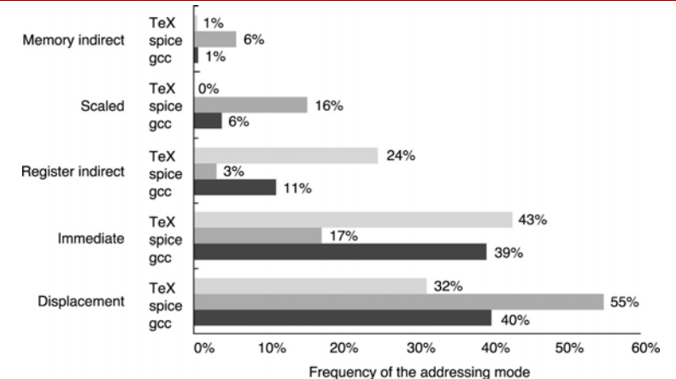
Memory Addressing Mode - Use
• Figure A.7: measuring usage patterns on the VAX
– these five modes account for 97-99% of all memory accesses
– memory addressing account for 50% of all operand references

Slide 34
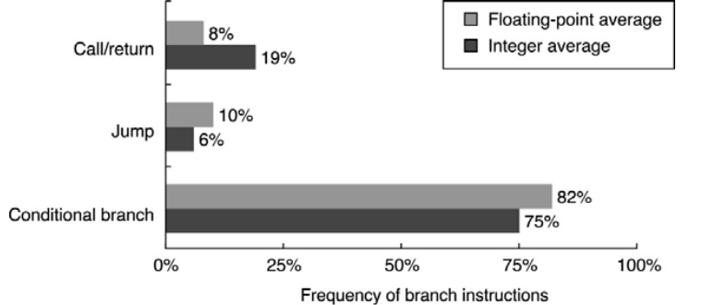
Measure: Instruction for Control Flow
(breakdown for Alpha μP with SPEC CPU2000)
• Figure A.14: conditional branch dominates. Nowadays three
techniques are mostly used to implement them
– condition-code (test special bits set by ALU operations)
– condition register (test arbitrary register with result of a comparison)
– compare & branch (compare operation is part of the branch instruction

Slide 35
Encoding an Instruction Set: Variable vs. Fixed
• variable encoding
– separate address specifier determines addressing modes for that operand
• fixed encoding
– addressing mode is within opcode: one memory operand and
a couple of addressing modes
• trade-off
• variable encoding gives better code size
minimize bit numbers to represent a program (instruction lengths vary widely)
• fixed encoding gives better performance
easier decoding, faster pipeline

